Slide 1
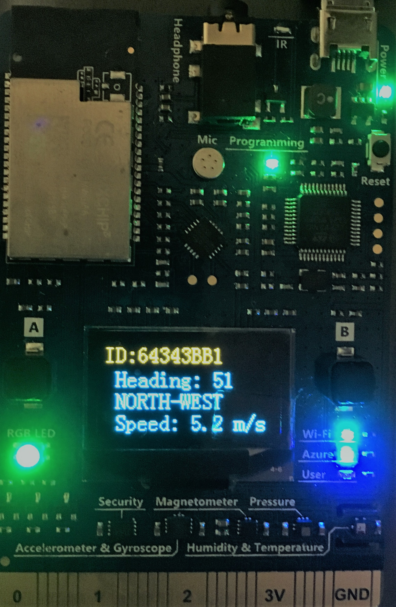







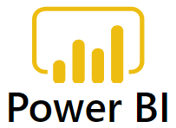
MxChip IoT Device / Windfarm Simulator
Stream Processing & Data Insights
Actions
Weather Station
IoT Hub
Stream
Analytics
Data Lake
Storage Gen1
Data Lake
Analytics
Azure
Function
Windfarm Simulator
TSI

Slide 2
Sub system Selection (Reason):
Data Lake Stg (DLS): The scenario required to store telemetry data for long term with ability to perform cold storage data analytics thru U-SQL queries which will require more read requests. DLS; although more expensive then blob, but it complies with Contoso Energy PoV requirements.
Data Lake Analytics(DLA) will facilitate on demand analytics, transform & extract valuable insights from weather station data from DLS through queries. DLA provide scalable, easy to develop and simple yet powerful U SQL query option.
Azure Function will trigger alert (on MxChip RGB) & action if the windspeed exceeds safe limits with device twin update
Core Systems/Services
MxChip
IoT Hub
Stream Analytics
Cosmos DB
Power BI
TSI
Sub System/Services
Data Lake Stg (Cold)
Data Lake Analytics
Azure Function

